Slide 1
Chapter 1 and 2

Slide 2
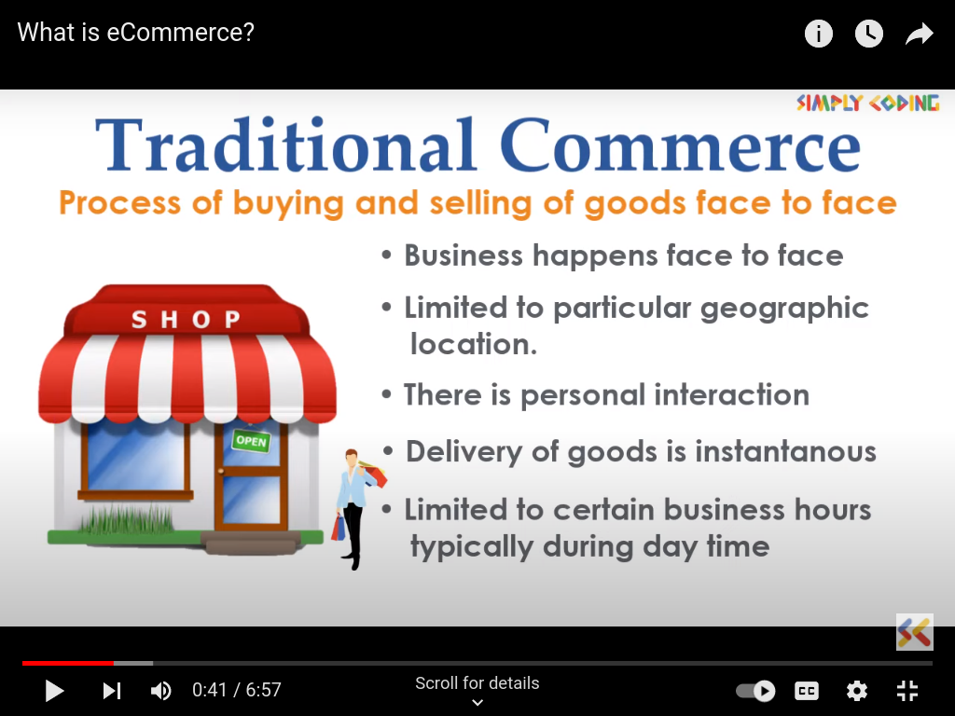
Traditional Commerce
Process of buying and selling of goods face to face
Business happens face to face
Limited to particular geographic location
There is personal interaction
Delivery of good is instantaneous
Limited to certain business hours typically during day time.

Slide 3
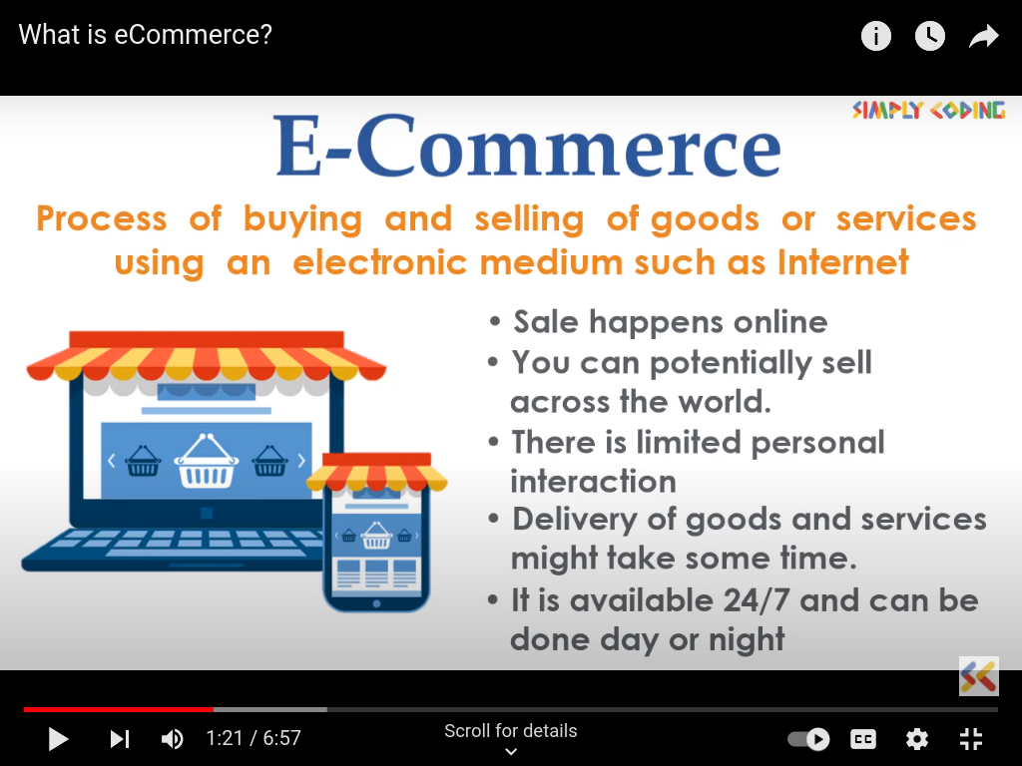
Introduction to E-commerce
process of buying goods or services using an electronic medium such as internet
Sales happens online
You can potentially sell across the world.
There is limited personal interaction.
Delivery of goods or services might take same time.
It is available 24/7 and can be done day or night.

Slide 4
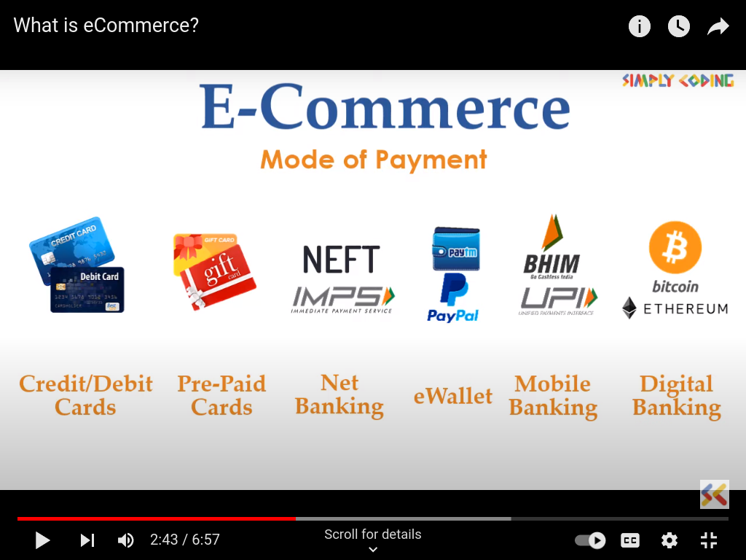
Introduction to E-commerce

Slide 5
Introduction to E-commerce
E-commerce (electronic commerce) is the buying and selling of goods and services, or the transmitting of funds or data, over an electronic network, primarily the internet.
The history of eCommerce is closely related to the history of the internet, and online shopping only became possible when the internet was opened to the public in 1991.

Slide 6
Brief History of E-Commerce
1970s
E- commerce meant the facilitation of commercial transactions electronically, using technology such as Electronic Data Interchange (EDI) and Electronic Funds Transfer (EFT), allowing businesses to send commercial documents like purchase orders or invoices electronically.

Slide 7
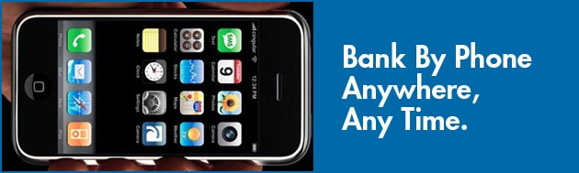
Brief History of E-Commerce
1980s
The growth and acceptance of credit cards
Automated teller machines (ATM)
Telephone banking
Airline reservation system

Slide 8
Brief History of E-Commerce
1990s
The Internet commercialized and users flocked to participate in the form of dot-coms, or Internet start-ups
Innovative applications ranging from online direct sales to e-learning experiences

Slide 9
Brief History of E-Commerce
2000s
Many European and American business companies offered their services through the World Wide Web.
Since then, People began to associate a word “e-commerce”

Slide 10
E-Commerce
Advantages:
Available 24/7
Provides a global reach
No need of intermediaries
Provides user with option to compare and select best option
Reduces paper work
Lower the transaction cost
Disadvantages:
Lack of personal touch
Requires an initial setup cost for hardware and fulfilment or returns
Security is key concern
-identity theft
-malware
- denial of services

Slide 11
Types of
Ecommerce
B2B (Business-to-business).
D2C (Direct-to-consumer)
C2B (Consumer-
to-business)
B2B2C (Business-to-
business-to-
consumer)
B2C (Business-to-consumer).
B2G (Business-to-government)
C2C (Consumer-to-consumer)

Slide 12
B2C (Business-to-consumer).
B2C businesses sell directly to their end-users. Anything you buy in an online store as a consumer — from wardrobe and household supplies to entertainment — is done as part of a B2C transaction.
The decision-making process for a B2C purchase is much shorter than a business-to-business (B2B) purchase, especially for lower-value items. Because of this shorter sales cycle, B2C businesses typically spend less marketing dollars to make a sale while having a lower average order value and fewer recurring orders than their B2B counterparts.
B2C includes both products and services as well. B2C innovators have leveraged technology like mobile apps, native advertising and remarketing to market directly to their customers and make their lives easier
Example: Dell selling laptops to customers, amazon, flipkart.

Slide 13
B2B (Business-to-business)
In a B2B business model, a business sells its product or service to another business. Sometimes the buyer is the end-user, but often the buyer resells to the consumer. B2B transactions generally have a longer sales cycle, but higher-order value and more recurring purchases.
Recent B2B innovators have made a place for themselves by replacing catalogs and order sheets with ecommerce storefronts and improved targeting in niche markets.
In 2021, 60% of B2B buyers were millennials — nearly double the amount from 2012. As younger generations enter the age of making business transactions, B2B selling in the online space is becoming more important.
Example: A company sell products to wholesaler, who will sell products to final customers.
Intel selling microprocessor to Dell
Heinz selling ketchup to Mcdonalds

Slide 14
B2B2C (Business-to-business-to- consumer)
B2B2C stands for Business-to-Business-to-Consumer. It is a business model where a company sells its product or service in partnership with another organization to an end customer.
Unlike when you white label a product — where a company rebrands an item to present it as its own — the end customer understands that they are buying a product or using a service from the original company
Example: Intel and Dell produce laptops in partnership to sell it to the customers.

Slide 15
B2G (Business-to-government)
Business-to-government (B2G) is an ecommerce model where a business sells and markets its products to government entities or public administrations — whether local, county, state or federal.
This model relies on the successful bidding of government contracts. A government agency will typically put up a request for proposal (RFP) and ecommerce businesses will have to bid on these projects.
While a more secure business model, B2G differs from other businesses or consumers. The bureaucratic nature of government agencies often leads to a much more glacial pace, which can limit potential revenue streams.
Example: Business pay taxes, file reports, or sell good and services to Government agencies.

Slide 16
C2B (Consumer-to-business)
C2B businesses allow individuals to sell goods and services to companies. In this ecommerce model, a site might enable customers to post the work they want to be completed and have businesses bid for the opportunity. Affiliate marketing services would also be considered C2B.
The C2B e commerce model’s competitive edge is in pricing for goods and services. This approach gives consumers the power to name their prices or have businesses directly compete to meet their needs.
Recent innovators have used this model creatively to connect companies to social media influencers to market their products.
Example: Social media influencers being paid bybusinesses to advertise their products.

Slide 17
D2C (Direct-to- consumer)
A direct-to-consumer business sells its own product directly to its end customers, without the help of third-party wholesalers or online retailers.
As opposed to other business models such as B2B2C, there is no middle man between the consumer and a business.
Example: customer directly buys product from company’s warehouse or outlet.

Slide 18
C2C (Consumer- to- consumer)
C2C ecommerce businesses — sometimes referred to as online marketplaces — connect consumers to exchange goods and services and typically make their money by charging transaction or listing fees.
C2C businesses benefit from self-propelled growth by motivated buyers and sellers, but face a key challenge in quality control and technology maintenance.
Online businesses like Craigslist, Walmart, Alibaba and eBay pioneered this model in the early days of the internet.
Example: Consumer to consumer sales take place on platforms like OLX, Etsy, and Fiverr also.
Customer selling car to another customer on OLX.

Slide 19
Requirements of security in E-commerce
Security is an essential part of any transaction that takes place over the internet. Customers will lose his/her faith in e-business if its security is compromised. Following are the essential requirements for safe e-payments/transactions
Confidentiality − Information should not be accessible to an unauthorized person. It should not be intercepted during the transmission.
Integrity − Information should not be altered during its transmission over the network.
Availability − Information should be available wherever and whenever required within a time limit specified.
Authenticity − There should be a mechanism to authenticate a user before giving him/her an access to the required information.
Non-Repudiability− It is the protection against the denial of order or denial of payment. Once a sender sends a message, the sender should not be able to deny sending the message. Similarly, the recipient of message should not be able to deny the receipt.
Encryption − Information should be encrypted and decrypted only by an authorized user.
Auditability − Data should be recorded in such a way that it can be audited for integrity requirements.

Slide 20
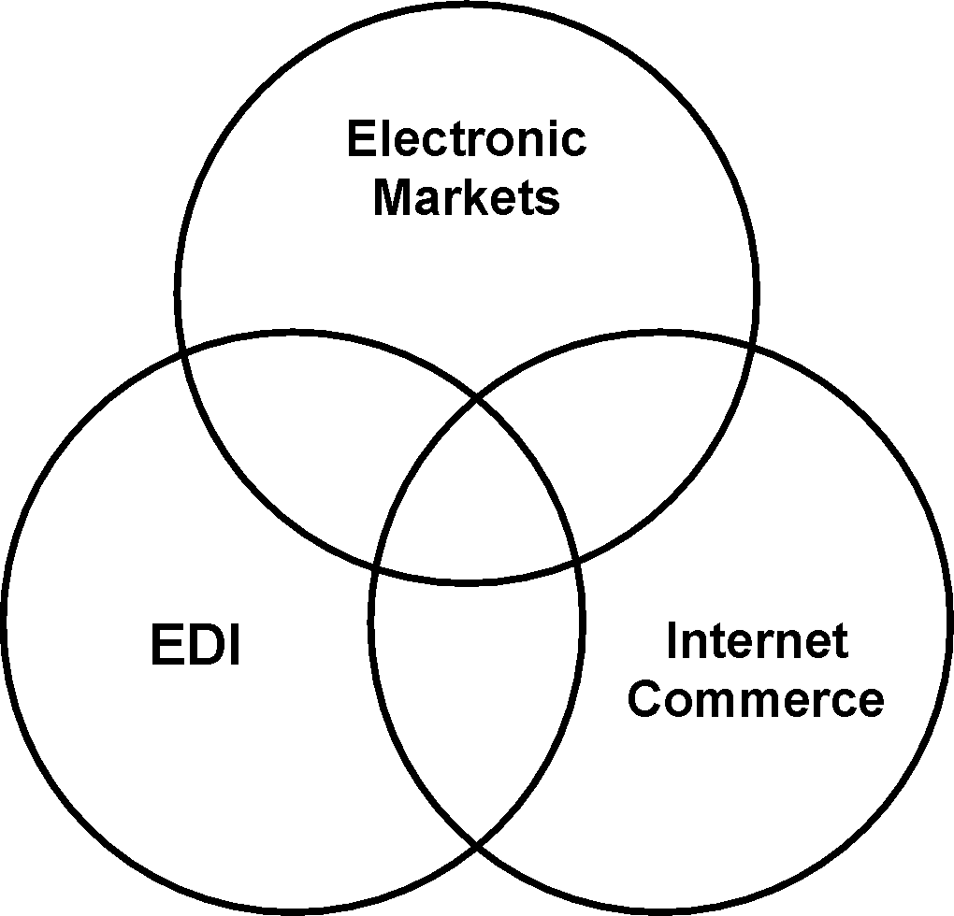
E-Commerce technologies
The three e-Commerce technologies are:
Electronic Markets
Electronic Data Interchange
Internet Commerce

Slide 21
Electronic markets
The use of information and communications technology to present a range of offerings available in a market segment and hence enable:
the purchaser to compare the prices (and other attributes);
make a purchase decision.
The usual example of an electronic market is an airline booking system.
There is the potential for new electronic markets to be created using Internet technologies.

Slide 22
Electronic Data Interchange (EDI)
EDI provides a standardised system for coding trade transactions so that they can be communicated directly from one computer system to another.
EDI removes the need for printed orders and invoices and avoids the delays and errors implicit in paper handling.
EDI is used by organisations that make a large number of regular transactions. Examples are the large supermarket chains and the vehicle assemblers which use EDI for transactions with their suppliers.

Slide 23
Internet Commerce
Information and communications technologies can also be used to advertise and make once-off sales of a wide range of goods and services.
This type of e-Commerce is typified by the commercial use of the Internet. The Internet can, for example, be used for the purchase of books that are then delivered by post or the booking of tickets that can be picked up by the clients when they arrive at the event.
It is to be noted that the Internet is not the only technology used for this type of service and this is not the only use of the Internet in e-Commerce.

Slide 24
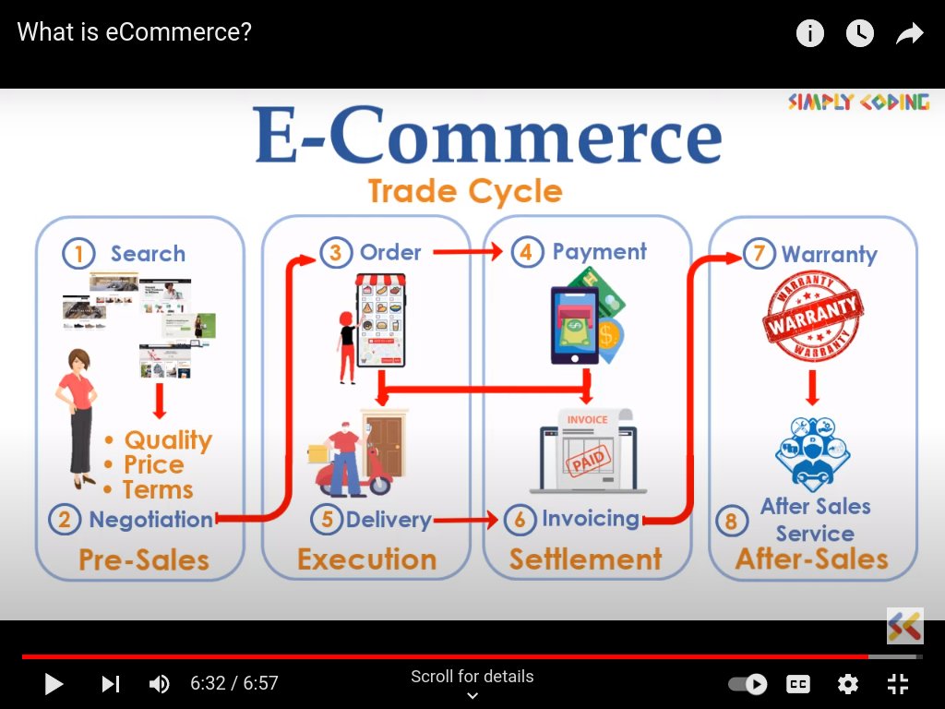
The trade cycle

Slide 25
The trade cycle
Conducting a commercial transaction involves the following steps:
Pre-Sale:
Search - finding a supplier
Negotiate – agreeing the terms of trade
Execution:
Order
Delivery
Settlement:
Invoice
Payment
After-sales, e.g. warranty and service

Slide 26
Business applications
Email
Instant messaging
Online shopping and order tracking
Online banking
Shopping cart software
Teleconferencing
Electronic tickets

Slide 27
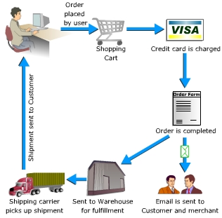
Example:
Online shopping

